Slide 1

The Machine Learning Process
How do I make my pandas DataFrame smaller and faster?
Reza Dibaj

Slide 2
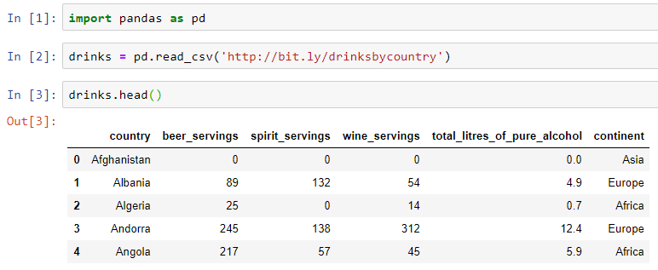
More Efficient pandas DataFrame
Let’s pull up an example dataset as follows:
Notes:
import pandas as pd
drinks = pd.read_csv('http://bit.ly/drinksbycountry’)
drinks.head()

Slide 3
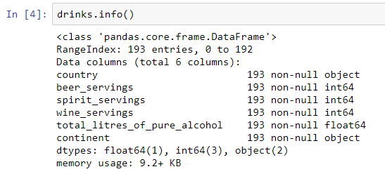

More Efficient pandas DataFrame
DF.info() provides some detail on our dataset.
Object means a string is being stored
You can store arbitrary Python objects, such as Python lists or Python dictionaries and pandas stores reference to that object.
Notes:
drinks.info()

Slide 4
More Efficient pandas DataFrame
Because object columns are references to other objects, pandas wants this info method to run fast, so it does not check the actual object, and it uses estimation and how much the references might take to those references.
Notes:
drinks.info()

Slide 5
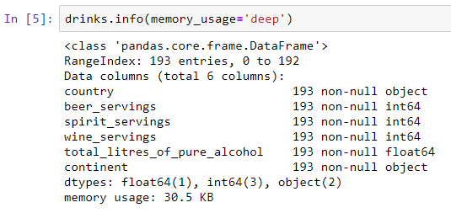
More Efficient pandas DataFrame
The following is how we can find out the true memory usage:
Notes:
drinks.info(memory_usage='deep')

Slide 6
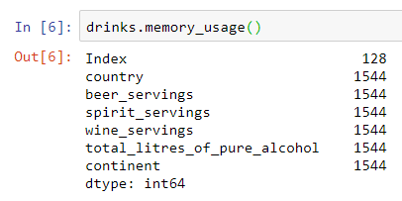
More Efficient pandas DataFrame
Here is how we measure each column’s memory usage:
But it does not inspect those object columns by default.
Notes:
drinks.memory_usage()

Slide 7
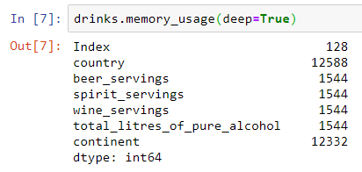

More Efficient pandas DataFrame
The following is the way that we can find out the real memory usage:
And here is the summation of memory usage that we saw in two slides before.
Notes:
drinks.memory_usage(deep=True)
drinks.memory_usage(deep=True).sum()

Slide 8

Group Discussion
How can I be more space efficient, especially with object columns?

Slide 9
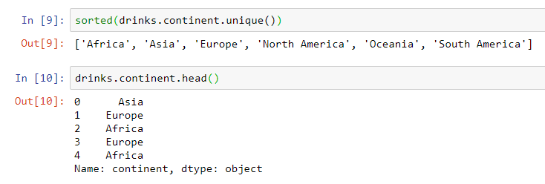
More Efficient pandas DataFrame
What if we could store our strings as integers?
0
1
2
3
4
5
1
2
0
2
0
Notes:
sorted(drinks.continent.unique())
drinks.continent.head()

Slide 10

More Efficient pandas DataFrame
In the next step we need to invent a lookup system. i.e. when I say 0 it means Africa.
The good news is pandas has created this system for us!

Slide 11
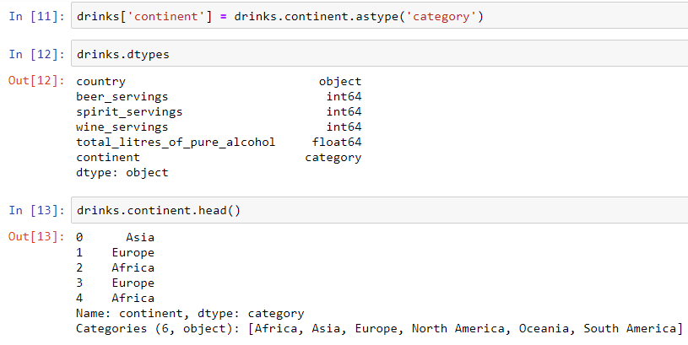
More Efficient pandas DataFrame
The following shows how we convert an object type to a category.
Converted to integer
Notes:
drinks['continent'] = drinks.continent.astype('category’)
drinks.dtypes
drinks.continent.head()

Slide 12
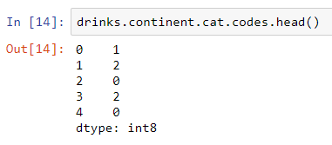
More Efficient pandas DataFrame
Let’s see how actually the category values are stored:
Such as str for string
Notes:
drinks.continent.cat.codes.head()

Slide 13
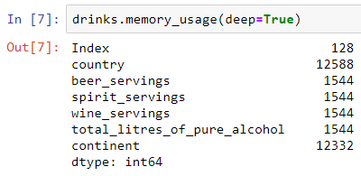
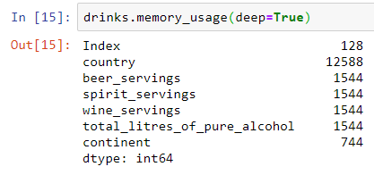
More Efficient pandas DataFrame
How memory efficient is this method?
Before
After
Notes:
drinks.continent.cat.codes.head()

Slide 14

Group Discussion
Is it going to improve the memory efficiency if we apply the same method on the country column?
Notes:
drinks['country'] = drinks.country.astype('category')

Slide 15

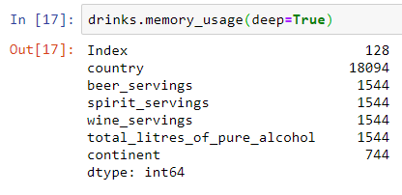
More Efficient pandas DataFrame
It exacerbate the problem…. Why?!
Before
After
Notes:
drinks.continent.cat.codes.head()

Slide 16
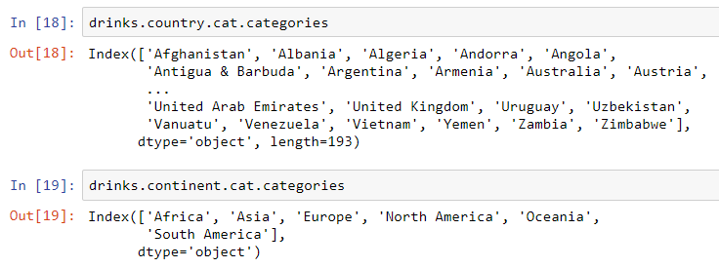
More Efficient pandas DataFrame
Look at the number of items in each category:
Notes:
drinks.country.cat.categories
drinks.continent.cat.categories

Slide 17
More Efficient pandas DataFrame
Using the category datatype in a correct way, would speed up the computation, such as using “groupby” and so on.
In short, using the category decreases the memory usage and increases the computation speed.
Notes:
drinks.info()

Slide 18

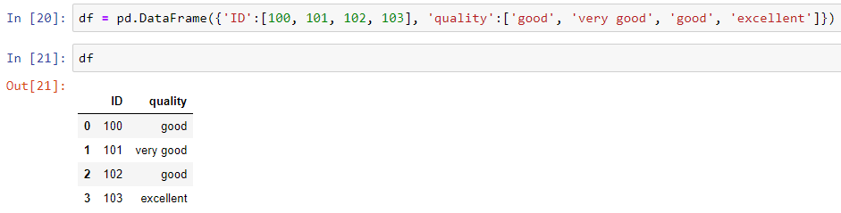
Bonus Tip
Let’s create a DF, using a dictionary method as follows:
Notes:
df = pd.DataFrame({'ID':[100, 101, 102, 103], 'quality':['good', 'very good', 'good', 'excellent’]})
df

Slide 19
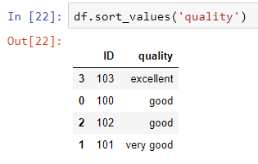
Bonus Tip
If we sort the DF based on the quality Series, it will sort it alphabetically.
Notes:
df.sort_values('quality')

Slide 20
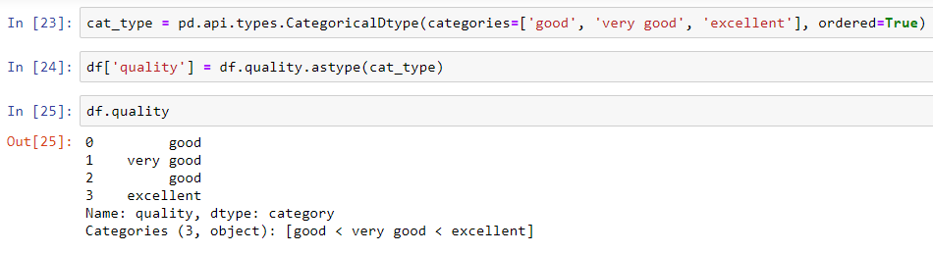
Bonus Tip
How can we tell pandas that there is logical ordering in the quality Series?
We need to define an ordered category datatype as follows:
Notes:
cat_type = pd.api.types.CategoricalDtype(categories=['good', 'very good', 'excellent'], ordered=True)
df['quality'] = df.quality.astype(cat_type)
df.quality

Slide 21
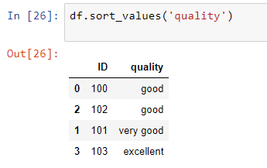
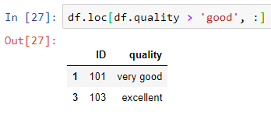
Bonus Tip
And here is the sorted DF, based on the quality as follows:
And if we want to use comparison operations:
Notes:
df.sort_values('quality’)
df.loc[df.quality > 'good', :]

Slide 22

Thank you
Question?
To be
Not to be

